Slide 1
Test Systems Using LXI
LAN eXtentions for Instrumentation
LXI Consortium Presentation
Aug 5, 2017
Notes:
Welcome to this series of presentations on LXI.
This presentation will focus on various applications of Test Systems that use LXI Devices. There are core features that all LXI Devices have in common that enhance building a test system, but there are also unique extended functions available in LXI that can address tough measurement applications.

Slide 2
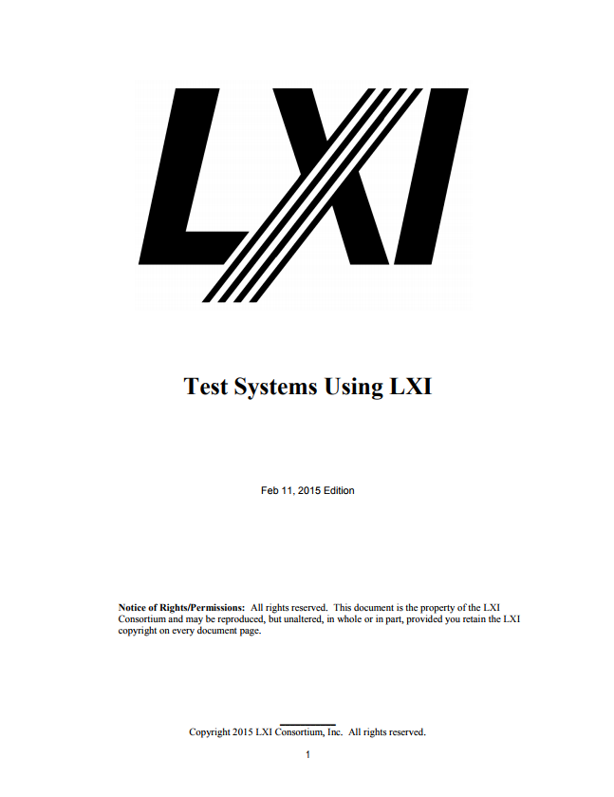
Test Systems Using LXI
LAN eXtentions for Instrumentation
LXI Consortium Presentation
Aug 5, 2017
Notes:
Key points of this presentation were taken from the LXI Consortium document Test Systems Using LXI. That document can be found on the LXI Consortium web site and provides much more detailed information about various LXI Devices and how they can address almost any type of measurement application.
The last slide in this presentation gives you a specific URL to locate this and other LXI documents.

Slide 3
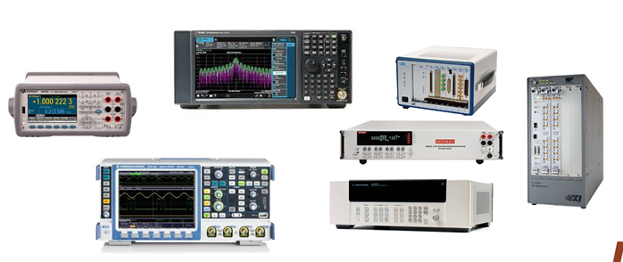
LAN Features that enhance Test Systems
High performance data transfers
Low cost, readily available infrastructure
Flexibility for wired or wireless communication
Local and Remote (synchronized) access
Abundance of multiple protocols for varied functionality
Ability to embed Web servers within each instrument
…adding LAN to an instrument is a start, but you need more
Notes:
LAN Connectivity is common, fast, inexpensive, and reliable…all features you want in a test system. However, adding LAN to an instrument does not mean all devices work the same when connecting to LAN.

Slide 4
LXI – more than just LAN-based Devices
All LXI Devices connect the same over LAN
All LXI Devices have IVI Driver for quick programming
Most LXI Devices have Web Monitoring/Control
LXI stand-alone, LXI to PXI, and LXI to VXI choices
Over 3600 Instruments are LXI Conformant
…covering 50 product categories:
Notes:
LXI (LAN eXtensions for Instrumentation) is the standard for Ethernet control of instrumentation in the test and measurement industry.
Prior to this standard there were LAN-based instruments, but there were almost as many different ways of configuring these devices as there were products. With the LXI Standard, all devices behave the same when connecting to LAN, they all come with easy to use IVI Drivers, example programming, and most have added Web Pages for monitoring and controlling functionality. ..and there are more than 3600 products in over 50 different product families.
LXI is particularly favored by the aerospace/defense industry where strict adherence to standards and compliance is a necessity.
By standardizing and extending the LAN to instrumentation support, LXI simplifies the use of Ethernet for test systems, providing a low-cost, cross-platform computer interface that can be controlled at any distance.

Slide 5
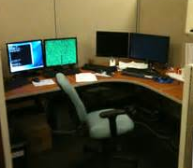
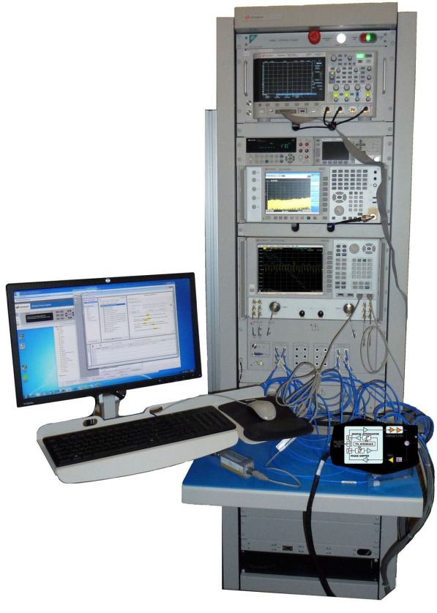
LXI expands Test System access
You want to work here…
14000 km
60 meters
…but your Test Systems are way over there
…and in a noisy environment.
Notes:
For a test system engineer, it is usually inconvenient and uncomfortable to work next to the test system. You want the comfort of a quiet office environment to develop your test programs, and you may be supporting a test system not even in your facility.

Slide 6
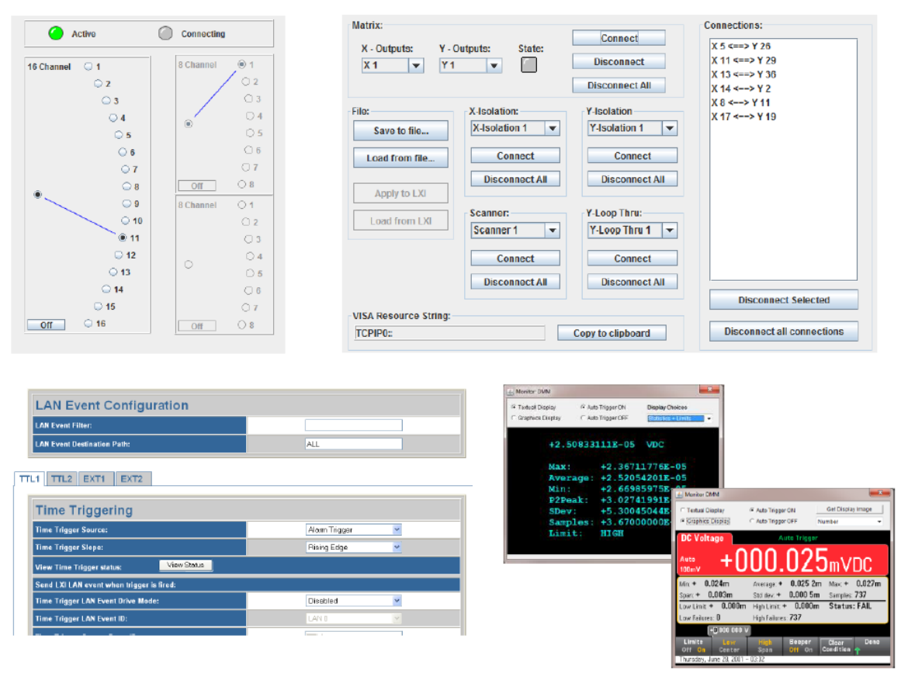
Built-in Web Servers enhance productivity
Notes:
The Test Systems covered in this presentation all benefit the Test System Engineer by providing built-in Web Servers. This enhances productivity, since the test developer can see what is happening as the test program is implemented. And, if something stops working properly, visibility into switching and instrument configuration can quickly identify issues.

Slide 7
LXI–based Test System Examples
PXIe Module Tester
Wind Tunnel Testing
Long Distance Testing
LXI Bridge Test Systems
…hardly an application LXI-based products can’t address
Notes:
Here are the Test Systems covered in this presentation. Just from these images you can determine that LXI covers not only proprietary implementations for signal generation, signal measurement, and switching, but you will note the presence of VXI and PXI modules through the use of LXI Bridges

Slide 8
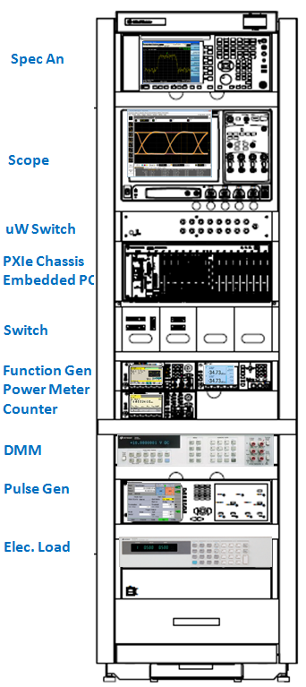
PXIe Module Tester
Multichannel IQ Arbs
Multichannel Stimulus/Response
DC to multi-GHz signals
Matrix, uWave, and GP Switching
Power supply loads
Tests all PXI and PXIe triggering
Uses Embedded PXIe Computer
Combines LXI, PXIe, USB, and GPIB
Test systems deployed in multiple locations in US and Asia
Notes:
This test system has a wide variety of instrumentation used to test various PXIe modules. The PXIe modules operate from DC to multi-gigahertz and must have each of their key specifications verified during production. This requires precision switching and precision instrumentation from DC to multi-gigahertz. Accuracy of a PXIe module requires the measurement or stimulus instruments have greater accuracy. This often dictates stand-alone products with lots of space for isolation of signals and their own power generation. This particular system also has electronic loads for testing module power supplies, which requires significant power dissipation and dictates a stand-alone solution. The combination of measurement needs has resulted in a hybrid system where there is one USB and two GPIB devices, with the rest all LXI.
The test system utilizes an embedded computer in the PXIe mainframe, which controls all instrumentation in addition to controlling the PXIe modules, using IVI Drivers and sometimes direct control using the SCPI language. Each LXI Device connects to a multiport LAN Switch, which then connects to one of two LAN ports on the embedded computer. The other LAN port connects to the corporate LAN giving remote access to the test developers. This configuration was specifically chosen since there are three such systems located in geographically different locations, 1000’s of kilometers apart, and regular updates to tests and issue resolution can be performed remotely.

Slide 9
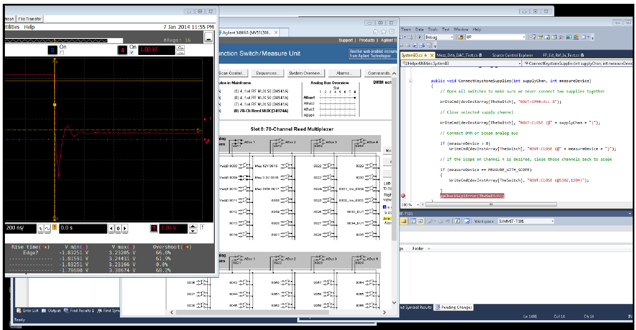
PXIe Module Tester
Remote Login to the Test System PC
LXI Devices on test system share a separate LAN with PC
IVI Drivers provide quick access to LXI Device functionality
Monitor/debug code via Web Pages
Test
Program
Web Page
Scope
Web Page
Switching
Notes:
With a Test System full of various signal generation, measurement, and switching products, you need a way to see what is going on…especially if you are trouble-shooting remotely.
It is a common solution to Remote Login to your test system…nothing special about that. But, with LXI Devices, that remote connection then provides Web Page access to the various measurement and control devices. For example, a test is failing, so you step through the test program looking at the result on the Scope Web page. Hmmm…not right…so, you check the switch path using the Switch Web Page. Ah…wrong combination of switches…problem solved! And, it was all identified remotely.

Slide 10
Wind Tunnel Testing
Can test aircraft and vehicles
Measuring Force, Pressure, and Airflow Patterns
Notes:
Wind tunnel facilities provide the equipment and expertise to develop and conduct tests used to characterize the aerodynamic and propulsion parameters of aircraft and vehicles.
The heart of the wind tunnel is used to perform a variety of tests including force tests, pressure tests, and airflow pattern measurements. These types of tests require large data collection and high speeds to capture performance data. To reduce measurement signal connection lengths and those types of issues, the measurement devices are often installed as close as possible to the DUT…but far away from the control room.

Slide 11
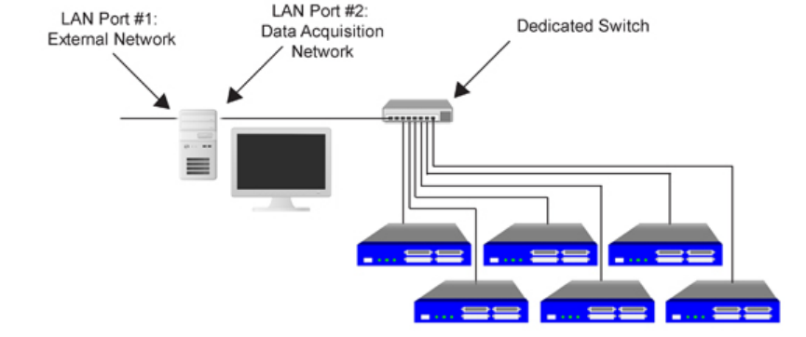
Wind Tunnel Testing
Dedicated Gigabit subnet
Guarantees network bandwidth for continuous data streaming
Easy scalability
Web Interface used for configuration of each LXI Device
Developers can remote login and also monitor each unit with Web Page
Notes:
Using dedicated subnets for LXI-based DAQ applications guarantees the availability of network bandwidth for continuous data streaming and easy scalability. Configuration is accomplished via a built-in standardized web interface for each LXI Device. This remote-access capability is suitable for wind tunnel testing where test engineers can access acquired data from any location.

Slide 12
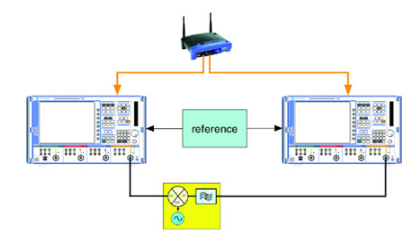
Group Delay Testing – using LXI Event Messaging
LXI Event Messaging allows Master-Slave control
Results on Display and can be accessed via Web Page over wireless connection
100-200 meters
Notes:
In this Long Distance Application, it is possible to measure group delay on a transmission system by means of two LXI-based network analyzers, one at the transmitting end and the other at the receiving end, that communicate with one another using LAN messages from 100 to 200 meters apart. The LXI network analyzers are connected to one another via a LAN router with an integrated DHCP server that assigns the IP addresses to the devices. Alternatively, the devices can use fixed IP addresses.

Slide 13
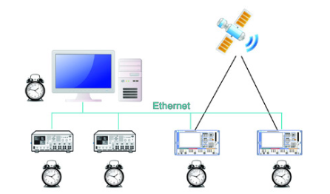
Satellite Testing – LXI Clock Synchronization
IEEE 1588-2008 Protocol synchronizes real-time clocks
Sub-microsecond time synch possible
Timer events scheduled in LXI Devices to absolute time
Notes:
Satellites are involved in a wide range of applications including scientific research, weather prediction, navigation, and military/aerospace. The greatest numbers of satellites that orbit the earth today are used for communications, enabling people across the globe to communicate with one another. In fact, more than half of the satellites in space are used for telecommunications. Beyond telecommunications, satellite communications are intrinsically tied to almost every aspect of our daily lives whether we realize it or not.
The LXI Clock Synchronization extended function inherits IEEE 1588-2008 Precision Time Protocol used to synchronize real-time clocks with sub-microsecond accuracy in devices of a networked distributed system. This allows common timer events to be tied to absolute times for very precise triggering and synchronization and enables the correlation between instruments to aid monitoring and debugging.

Slide 14
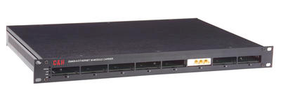
Hybrid Test Systems – LXI Bridges
PXI or VXI Controller is LXI Conformant
No need to power down PC when connected to chassis
Built-in drivers to control modules
Retain legacy modules for new test systems
Web Page access to modules
LXI Extended Functions used to control backplane triggering
Notes:
Companies such as VTI Instruments and Pickering Interfaces provide LXI Bridges that enable the re-use of expensive modules to be deployed to new test systems.
The LXI chassis has an embedded controller that requires access to source code for the modules supported, which are often restricted to the company’s modules. The same controller gives the user a barrier between the modules and the test system computer that provides all the features of Ethernet connectivity, including web-based management of the modules. In this case, the LXI Bridge device permits cycling power of the chassis without having to cycle power of the test system computer.
This LXI chassis now becomes just another component in a hybrid test system that can contain USB, GPIB, and LXI devices, similar to our first test system example.

Slide 15
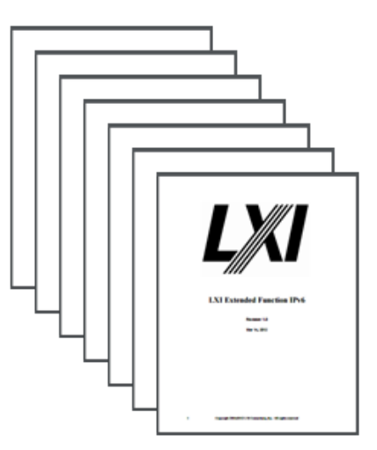
Next Steps – Guides/Videos for Using LXI
LXI Getting Started
Building LXI-Based Test Systems
Introducing LXI To Your Network Administrator
Maximizing Performance of LXI-Based Test System
Test Systems Using LXI
LXI Networking Basics
http://www.lxistandard.org/About/Guides-for-using-LXI.aspx
Notes:
You have learned a lot about using LXI Devices to create various test systems. You can learn much more detail accessing some of the same-named documents on the LXI Consortium website.
Thank you for your time.

